Slide 1
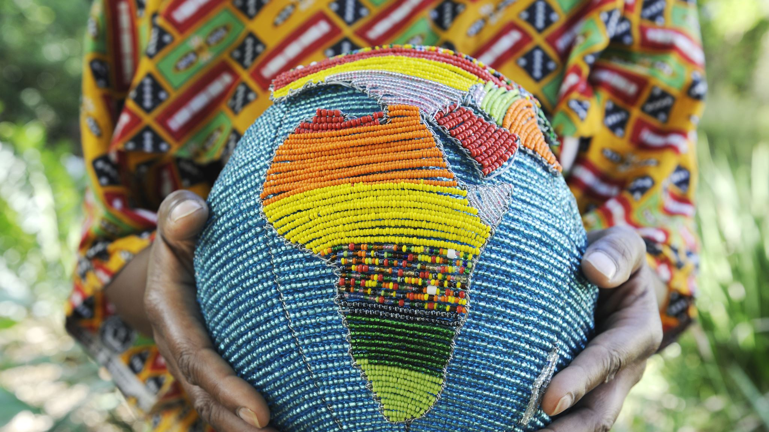
Cultural Preservation in the Senegambia Region: Challenges and Opportunities
Presented by:
Dr. Cherno Omar Barry
Associate Professor of Comparative Literature
International Open University

Slide 2
Introduction
• The Senegambia region is culturally diverse.
• Globalization and urbanization threaten cultural traditions.
• Overview of challenges and preservation efforts.

Slide 3
Historical and Cultural Context
• Major ethnic groups: Fulani, Wolof, Manding, Serer, Serahule.
• Trade, migration, and colonial history shaped cultural practices.
• Influence of oral traditions and religious transformations.

Slide 4
Methodology
• Mixed-methods approach: Qualitative and quantitative research.
01
• Data collection: Interviews, surveys, and literature review.
02
• Challenges: Geographic scope, historical record limitations.
03

Slide 5
Key Aspects of Cultural Heritage
• Oral traditions: Griots and storytelling.
• Artisanal crafts: Weaving, pottery, wood carving.
• Religious practices and language decline.

Slide 6

Challenges to Cultural Preservation
• Globalization: Western media and cultural homogenization.
• Urbanization: Migration impacting knowledge transmission.
• Language decline and environmental threats.

Slide 7
Community-Led Preservation Efforts
• Grassroots movements and cultural festivals.
• Women’s and youth-led initiatives.
• Digital platforms supporting traditional knowledge.

Slide 8
Government and Policy Interventions
• Cultural heritage policies in Senegal and The Gambia.
• Education reforms integrating indigenous knowledge.
• Funding and enforcement challenges.

Slide 9
International Collaboration & UNESCO
• UNESCO’s Memory of the World project.
• Digital archives and heritage sites.
• International partnerships for preservation efforts.

Slide 10
Technology in Cultural Preservation
• Digital storytelling and online archives.
• Language learning apps and social media influence.
• Balancing modernization with cultural integrity.

Slide 11

Emerging Trends – Hybrid Identities
• Young generations blending traditional and modern cultures.
• Fashion, music, and arts reflecting cultural fusion.
• The debate between adaptation and cultural loss.

Slide 12

Case Studies of Successful Programs
• Oral traditions: UNESCO’s storytelling archives.
• Bilingual education integrating local languages.
• Cultural festivals promoting economic opportunities.

Slide 13

Recommendations for Sustainable Preservation
• Strengthen community involvement.
• Enhance government policies and funding.
• Leverage technology for cultural documentation.

Slide 14
Conclusion
• Senegambia’s cultural heritage faces challenges but is resilient.
• Sustainable preservation requires community, policy, and technology.
• Call to action: Engage stakeholders in cultural sustainability.

Slide 15

Q&A
Thank you for your attention! Open for questions.

